Slide 1
Exploring Multiple Intelligences, Interests and Values
Chapter 3

Slide 2


Slide 3
Multiple Intelligences
Developed by Howard Gardner
Defined as the human ability to solve problems or design or compose things valued in at least one culture
Broadens the scope of human potential

Slide 4
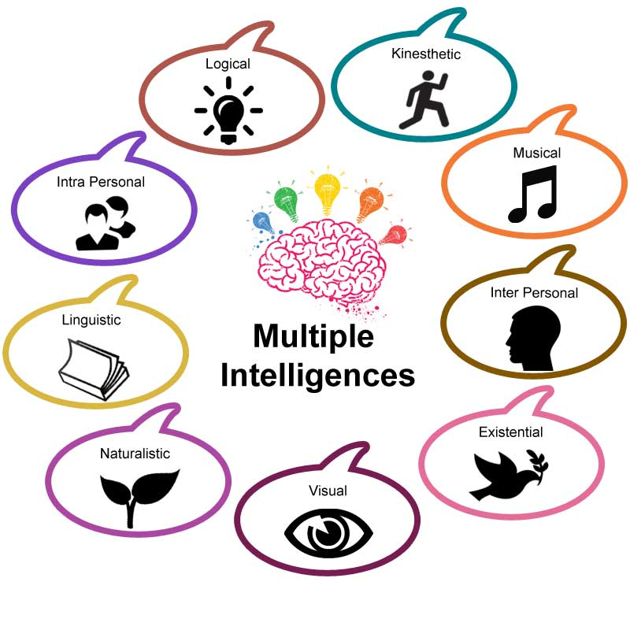

Slide 5
Three Factors
Heredity
Personal Life History
Cultural and historical background
Key Idea: You can develop your multiple intelligences.

Slide 6
Life History
Crystallizers promote the development of the intelligence.
Paralyzers inhibit the development of the intelligence.
What are some factors that affected your intelligences early in life?

Slide 7
Your textbook provides an opportunity to explore your multiple intelligences. Use the access code to take the AchieveWORKS Intelligences assessment.

Slide 8


Choose Your Career with Multiple Intelligence in Mind

Slide 9

Build on Your Strengths
Musical
Listening to music
Singing or playing an instrument
Recognizing musical patterns
Musical Smart
Careers
Disc Jockey
Music Teacher
Music Retailer
Music Therapist
Singer
Song Writer
Music Critic
Music Lawyer

Slide 10

Build on Your Strengths
Interpersonal
Communication
Social skills
Helping others
Resolve conflicts
People Smart
Careers
Cruise Director
Mediator
Human Resources
Dental Hygienist
Nurse
Psychologist
Social Worker
Marketer
Counselor

Slide 11
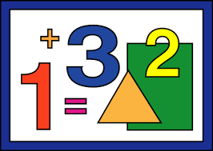
Build on Your Strengths
Logical-Mathematical
Math aptitude
Interest in science
Problem solving
Logical thinking
Number Smart
Careers
Engineer
Accountant
Computer Analyst
Physician
Detective
Researcher
Scientist
Economist

Slide 12
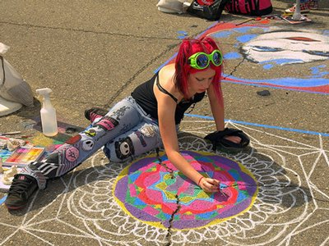
Build on Your Strengths
Spatial
Visualization
Navigation
Reading
Writing
Picture Smart
Careers
Architect
Artist
Film animator
Mechanic
Pilot
Webmaster
Interior decorator
Graphic artist
Photographer

Slide 13
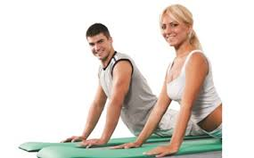
Build on Your Strengths
Bodily- Kinesthetic
Hand and eye
coordination
Athletics
Dance
Drama
Cooking
Learning by doing
Body Smart
Careers
Athlete
Carpenter
Craftsperson
Mechanic
Jeweler
Computer game designer
Firefighter
Forest ranger
Physical therapist

Slide 14

Build on Your Strengths
Linguistic
Reading
Writing
Vocabulary
Spelling
Good listener
Good memory
Word Smart
Careers
Journalist
Writer
Editor
Attorney
Curator
Newscaster
Politician
Librarian
Comedian

Slide 15

Build on Your Strengths
Careers
Career counselor
Wellness counselor Therapist
Criminologist
Intelligence officer
Entrepreneur
Researcher
Actor
Artist
Intrapersonal
Self-aware
Understand
emotions
Independent
Self-motivated
Self Smart

Slide 16
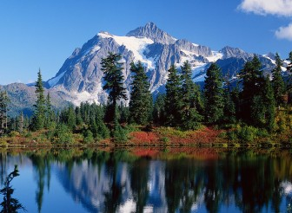
Build on Your Strengths
Naturalist
Aware of natural surroundings
Preserve the environment
Nature Smart
Careers
Park ranger
Dog trainer
Landscaper
Meteorologist
Veterinarian
Animal health technician
Ecologist
Wilderness guide
Environmental lawyer

Slide 17

Build on Your Strengths
Existential
Questioning
Purpose of life
Religious beliefs
Curiosity Smart
Careers
Counselor
Psychologist
Psychiatrist
Social worker
Ministry
Philosopher
Artist
Scientist
Researcher

Slide 18

Emotional Intelligence
Interpersonal + Intrapersonal
The ability to recognize, control, and evaluate your emotions while realizing how they affect other people

Slide 19
Emotional Intelligence
Two Parts:
Understanding yourself, your goals, intentions, responses and behavior
Understanding others and their feelings

Slide 20
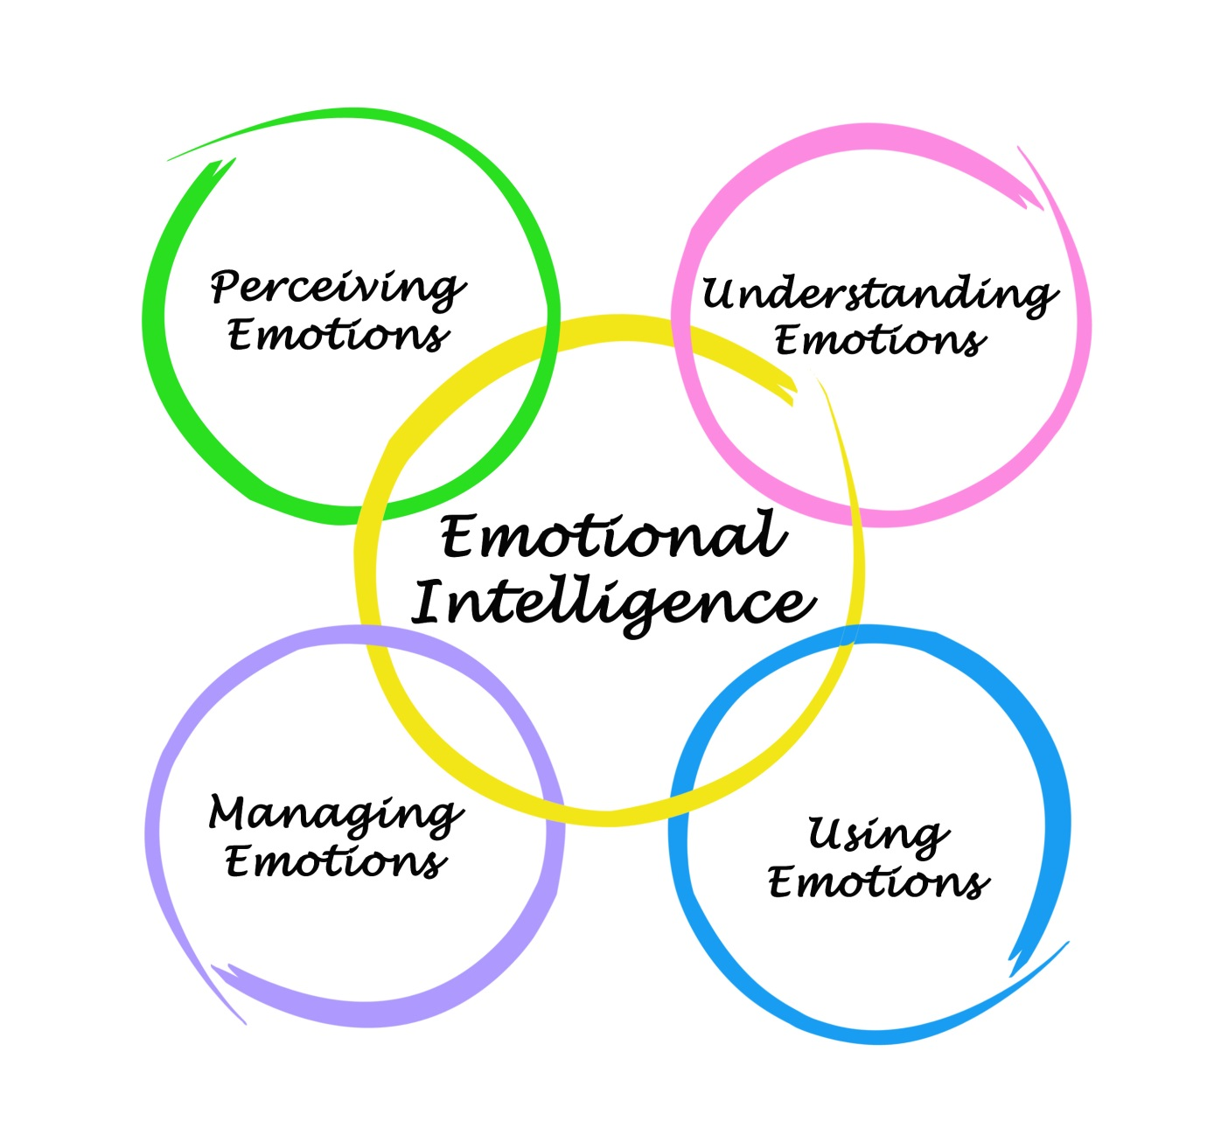
Emotional Intelligence

Slide 21
Emotional Intelligence
Express yourself
Work as part of a team
Concentrate
Remember
Make decisions
Deal with stress
Overcome challenges
Deal with conflict
Empathize with others

Slide 22

How Can You Develop Emotional Intelligence?

Slide 23
Developing Emotional Intelligence
Use empathy.
Think about how your actions affect others.
Be intellectually curious.
Give others credit for their accomplishments.
Work on stress management.
Take a college course on verbal and nonverbal communication.
Take responsibility for your actions.

Slide 24
These intelligences work together in complex ways to make us unique individuals.

Slide 25
Multiple Intelligences Matching Quiz
Michael Jordan
Aristotle
Martin Luther King Jr
Sigmund Freud
William Shakespeare
Albert Einstein
“Will. i am”
Charles Darwin
George Lucas
Musical hearing and remembering musical patterns
Interpersonal: understanding other people
Mathematical: working with numbers
Spatial: manipulating objects in space
Bodily-Kinesthetic: using your body
Linguistic: using language
Intrapersonal: understanding yourself
Naturalist: understanding the environment
Existential: pondering the meaning of life and our place in the universe.

Slide 26
Exploring Your Interests

Slide 27
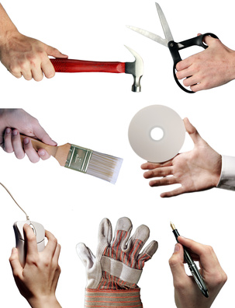
Interests
Knowing your
interests is helpful
in choosing a
major and
career.

Slide 28
The Interest Profiler*
Place a checkmark next to the items you might like to do.
You do not need to know how to do them or even have the opportunity to do them.
Don’t select items based on income.
You can earn higher income with more education.
For example, if you would like to build a brick walkway, you could work in construction or with more education, become a civil engineer.
*Available in the textbook

Slide 29
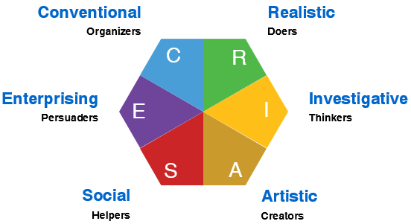
HOLLAND’S HEXAGON

Slide 30
Investigative Persons
Have a strong interest in science
Work with theories, analyze data and solve problems
Are analytical, curious, original and creative
Have good skills in math and science
Are employed in science or lab related work

Slide 31
Artistic Persons
Enjoy visual arts, music, drama or writing
Are creative and value self expression
Work in unstructured and flexible environments
Have artistic talent
Work in museums, theaters, concert halls, advertising

Slide 32
Social Persons
Like to work with people
Enjoy helping, nurturing and caring for others
Have social, communication and teaching skills
Humanistic, idealistic
Work in schools, social services, religious occupations, health care

Slide 33
Enterprising Persons
Like to persuade, lead or supervise
Have skills in selling and communication
Seek positions of leadership, status and power
Employed in business, government, sales and politics

Slide 34
Conventional Persons
Good at organizing and managing details
Like math, accounting, finance
Are efficient and patient
Prefer structure
Work in business, corporations, quality control, and financial institutions

Slide 35
Realistic Persons
Enjoy working with tools, machines, equipment
Often work outdoors
Are active and adventurous
Have good mechanical abilities
Are employed in manufacturing, construction, transportation and engineering

Slide 36
Exercise: What are 20 things you like to do?

Slide 37

Can you list 20 things you like to do in 5 minutes?

Slide 38
Now that you have your list, put a $ next to anything that costs more than $20 each time you do it.

Slide 39

Write P to the left of each item that you do with people.

Slide 40

Write I next to anything that you do by yourself (individually)

Slide 41
Write T next to the items that involve working with things.
Cars
Tools
Gardening
Crafts

Slide 42
Write D next to items that involve working with data.
Computers
Math
Budgeting
Organizing

Slide 43

Write A next to items that involve physical activity.

Slide 44
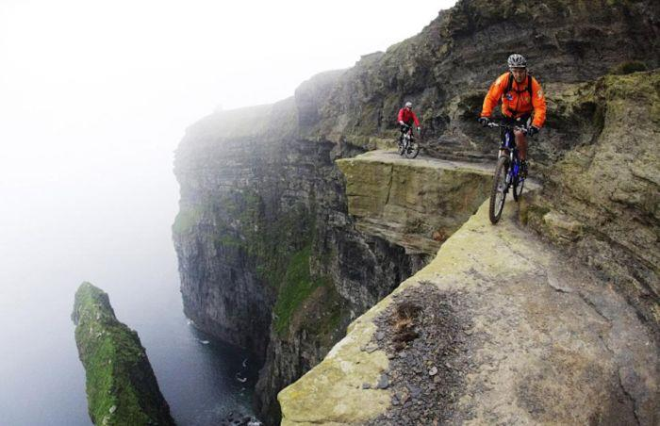
Write R next to items that involve risk or adventure
Car racing
Skiing
Motorcycle riding
Skydiving
Rock Climbing

Slide 45
Write MT next to the items you would like to spend more time doing.

Slide 46

Number 1-5 the most important items on your list.
What is your number one interest? Share it with the class.

Slide 47
20 Things You Like to Do
Answer questions at the end of this activity.

Slide 48

What kind of lifestyle do you prefer?

Slide 49
Lifestyle Triangle

Slide 50
Lifestyle
Look at the results of 20 Things You Like to Do.
Do you have a balance between leisure, socializing and work/study?

Slide 51
Exploring Your Values

Slide 52

What Are Your Values?

Slide 53

Values are:
What we think is important
What we feel is right and good

Slide 54

Where do we get our values?

Slide 55
Values come from:
Parents
Friends
Culture
Church
Media
Society

Slide 56
Assignment:
My Personal Coat of Arms
What you like about yourself
Your greatest achievement
Your most prized possession
What you value most in life
A symbol of your personality
Three words to be remembered by

Slide 57
Some samples

Slide 58


Slide 59
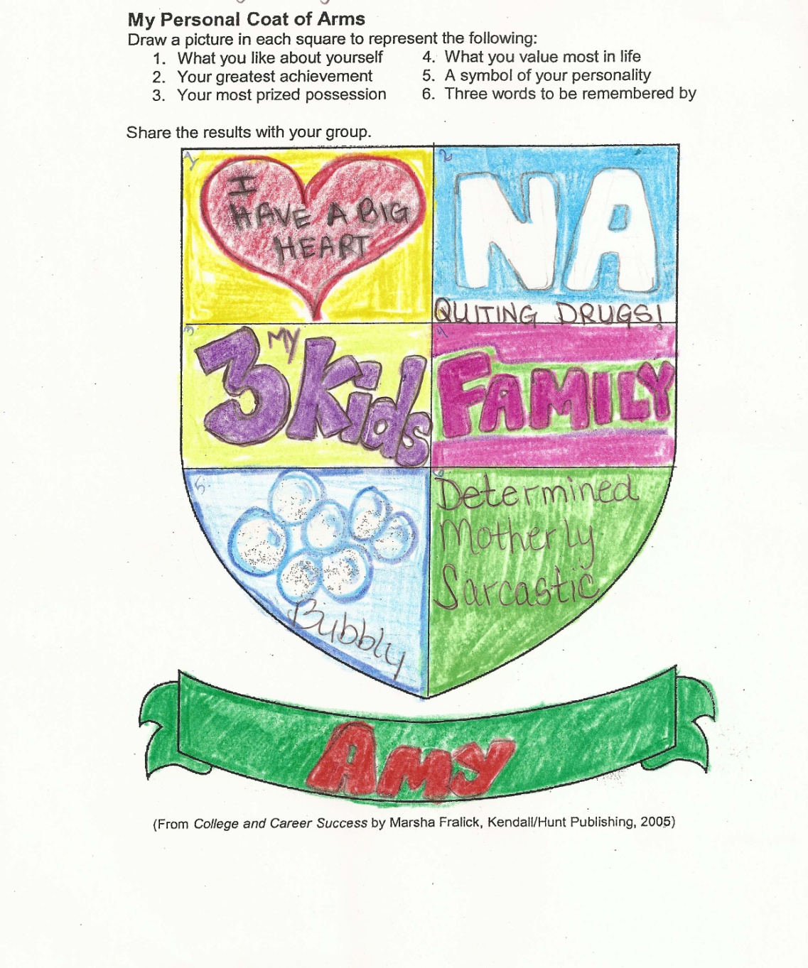

Slide 60


Slide 61
Complete:
Assessing Your Personal Values
Share your highest value with the class
Complete:
Summing Up Values

Slide 62

Making a Career Decision

Slide 63

There is a choice you have to make,
In everything you do.
And you must always keep in mind,
The choice you make, makes you.

Slide 64

Steps in Making a Career Decision
Self-assessment
  Personality, Interests, Values, Skills
Explore Options
Research careers
Plan your education
Make a commitment and take action
Evaluate
How is it working?

Slide 65
Planful Decisions
Weigh the consequences
What are the pros and cons

Slide 66
Use Planful Decisions for:
What is my major?
What is my career?
Who should I marry?

Slide 67
Steps in Planful Decisions
State the problem
Consider your values
What are your talents?
Gather information
Generate alternatives
Evaluate the pros and cons of the options
Select the best alternative
Take action

Slide 68

Group Activity: Planful Decision

Slide 69
Keys to Success:
Act on Your Values

Slide 70
Make important decisions based on your values
Should I go to college?
What is my major
What career should I choose?
Who should I marry?

Slide 71
Knowing your values is not enough.

Slide 72
Act on your values.

Slide 73
For example, if you value your good health, what actions will you take?

Slide 74

If you value a college education, you can find the motivation needed to be successful.

Slide 75
Group Activity: Values in Action

